Slide 1
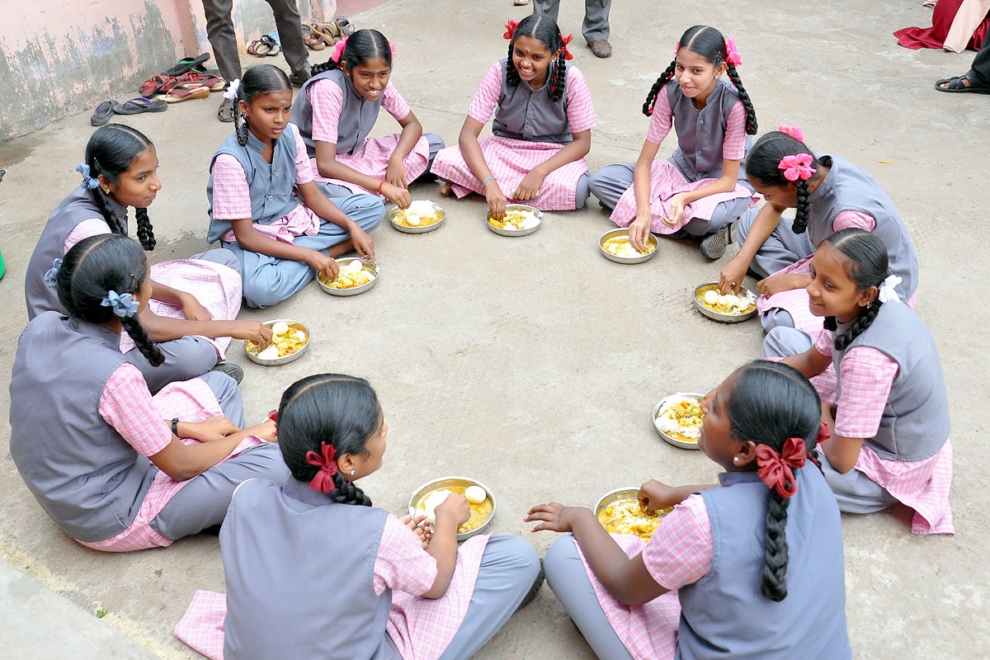
Government of Tamil Nadu
Mid Day Meal
Scheme
PAB Meeting
16.05.2019

Slide 2
NOON MEAL PROGRAMME
Across the State of Tamil Nadu, 43,283 Noon Meal Centres are functioning.
1,28,130 Noon Meal Employees have been engaged
43 lakhs children, studying in Primary & Upper Primary schools are provided with hot cooked nutritious variety meals on all school working days (220 days) inside the school campus itself.
5530 Children studying in National Child Labour Special Schools are also provided with Nutritious variety meals in 16 Districts for 312 days in a year.

Slide 3
Noon Meal Centres & Beneficiaries
Schools | Total No. of centers | 2019 - 2020
 |  | Enrolled |  |  | Proposed
 |  | Govt & LB | Govt Aided | Total | Govt & LB | Govt Aided | Total
Primary | 26,810 | 20,37,898 | 7,61,412 | 27,99,310 | 17,65,431 | 6,59,612 | 24,25,043
Upper Primary | 16,210 | 17,26,371 | 4,79,572 | 22,05,943 | 15,12,474 | 4,20,153 | 19,32,627
NCLP | 263 | 5,530 | 0 | 5,530 | 5,530 | 0 | 5,530
Total | 43,283 | 37,69,799 | 12,40,984 | 50,10,783 | 32,83,435 | 10,79,765 | 43,63,200
2018-2019 | 43,205 | 35,54,124 | 16,70,421 | 52,24,545 | 33,11,481 | 12,37,961 | 45,49,442

Slide 4
ORGANIZATION CHART
Hon'ble Minister (SW&NMP)
Principal Secretary (SW&NMP)
Commissioner (SW&NMP)
Joint Director (NMP)
Assistant Director (NMP)
Personal Assistant to District Collector
Accounts Officer (NP-MDMS)
Asst. Accounts Officer (NP-MDMS)
Section Supt. (3 Section)
Assistant (2 each Section)
Data Entry Operators (3 Nos)
Record Clerk / Officer Assistant & Sweeper
Asst. Accounts Officer
Block Development Officer
Dpty. B.D.O
Data Entry Operator
NM-Organizer
Cook
Cook Assistant
Assistant (2 Nos)
Typist & Data Entry Operator

Slide 5
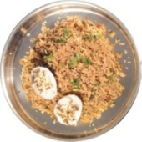
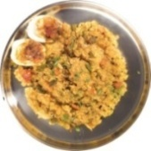
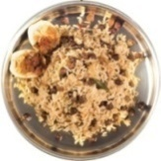
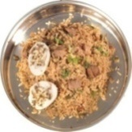
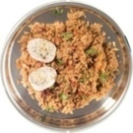
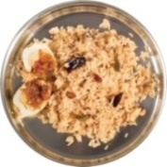
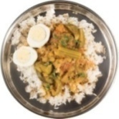
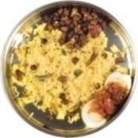
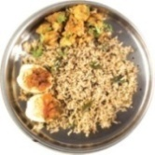
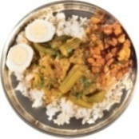
Best Practices - Menu details
Days | Images | 1st and 3rd week Menu | Images | 2nd and 4th week Menu
Monday |  | Vegetable Briyani + Pepper Egg |  | Sambar Sadham (Bisibelabath) + Onion Tomato Masala Egg
Tuesday |  | Black gram pulav + Tomato Masala Egg |  | Mixed Meal Maker & Vegetables Rice + Pepper Egg
Wednesday |  | Tomato Rice + Pepper Egg |  | Tamarind Rice + Tomato Masala Egg
Thursday |  | Rice + Sambar+Boiled Egg |  | Lemon Rice + Sundal + Tomato Egg
Friday |  | Curry Leaf Rice / Keerai Sadham + Masala Egg & Chilly Fried Potato |  | Rice + Sambar + Boiled Egg and Fried Potato

Slide 6
Nutrition Provided to the children under Mid Day Meals
S. No | Stage | GOI Norms |  | State Government Provision
 |  | Calories (In Kcl) | Protein (In gms) | Calories (In Kcl) | Protein (In gms)
1. | Primary | 450 | 12 | 553.30 | 18.12
2. | Upper Primary | 700 | 20 | 733.86 | 21.64

Slide 7
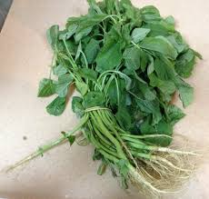
Best Practices - contd.,
Eggs are served to all enrolled beneficiaries from 1st std to 10th std on all school working days out of State budget.
Coloring scheme for eggs to prevent pilferage and staleness.
Banana weighing 100 gm is provided as an alternate to children who are not accustomed to eating egg
During 1st and 3rd week, on Friday Curry leaf rice (or) Keerai sadham should be provided to the children

Slide 8
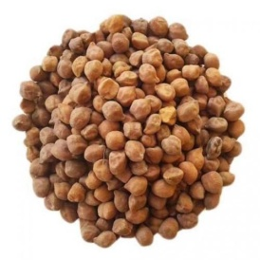
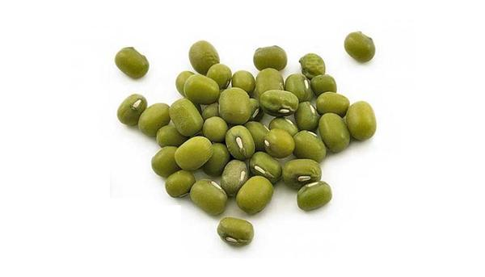
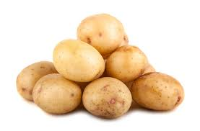
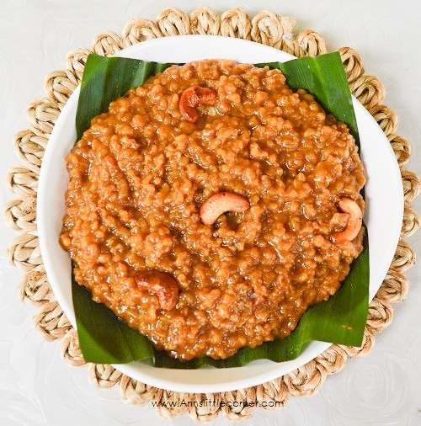
Best Practices - contd.,
During first and third week of a month, on Tuesday, 20 gms of ‘Black Bengal gram’ is provided to each child in the form of ‘Pulav’ During second and fourth week of a month on Thursday, 20 gm of Green gram is provided to each child in the form of ‘Sundal’. On all Fridays to increase the carbohydrate content, children are provided with 20 gm of chilly fried potato. During important occasions, Sweet Pongal is served to children by using Jaggery and ghee.

Slide 9
Best Practices – contd.,
Double Fortified Salt, fortified with Iron & Iodine is used for cooking in order to prevent the children from Iodine deficiency thereby eradicating goiter and to prevent anemia.
Double fortified oil, fortified with Vitamin A & D is cooking in order to supplement with Vitamin A & D.
Tamil Nadu Civil Supplies Corporation supplies rice, dhal, oil and salt at the doorsteps of the Noon Meal Centres in order to ensure quality and quantity.
4 sets of school Uniform, school Bags and Geometry box are provided for the children out of State funds for enhancing enrolment.
Out of State funds MDM is served to IX & X std children also.

Slide 10
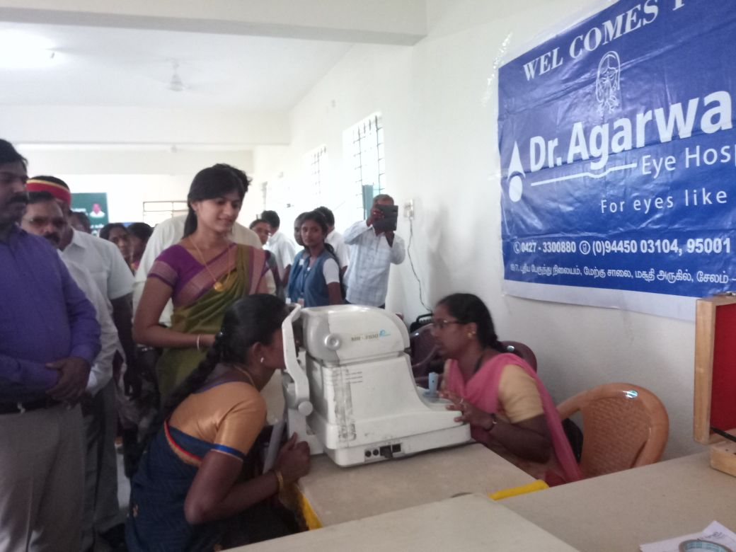
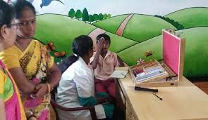
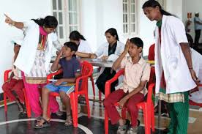
Health Camp for Noon Meal Employees & School children District Initiatives
Rashtriya Bal Swasthya Karyakram (RBSK)

Slide 11
Food Grain Management
Food Corporation of India
Tamil Nadu Civil Supplies Corporation
Noon Meal Centres
* Maintaining 45 days buffer stock at NMC level to provide meal without any delay

Slide 12
Benefits to Noon Meal Employees
1 | Special time scale of pay Organizer – Rs.7700 – Rs.24200 Cook – Rs.4100 – Rs.12500 Cook Asst – Rs.3000 – Rs.9000 | 7 | New Health Insurance Scheme
2 | Special monthly pension (Rs.2000/- per Month) | 8 | Maternity leave
3 | Lumpsum amount (Rs.1Lakh for Organizer & Rs.50,000/- for Cook & CCH on superannuation) | 9 | Family benefit fund
4 | Special provident fund | 10 | Compassionate ground Appointment
5 | General provident fund | 11 | Pongal bonus
6 | Festival advance

Slide 13
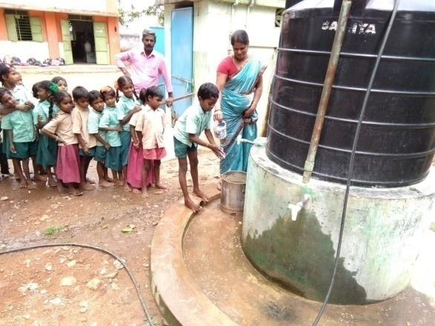
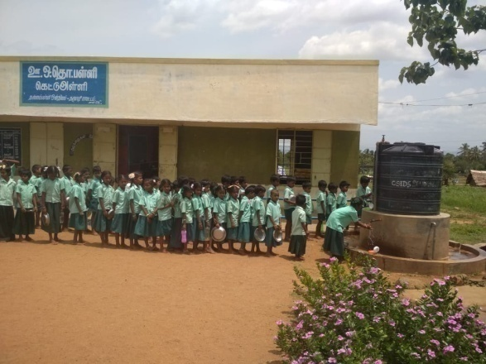
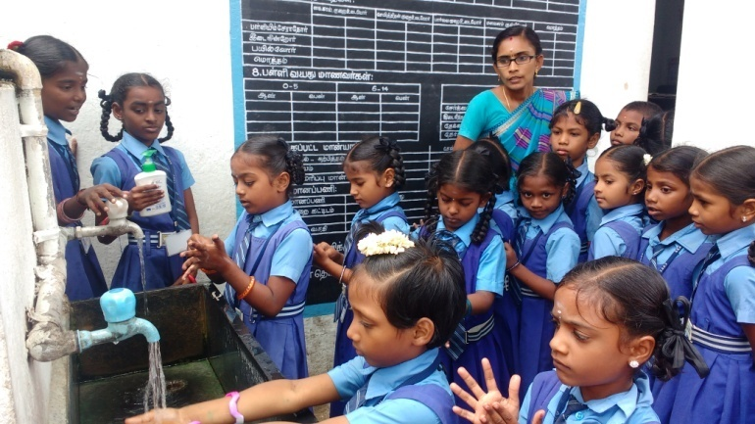
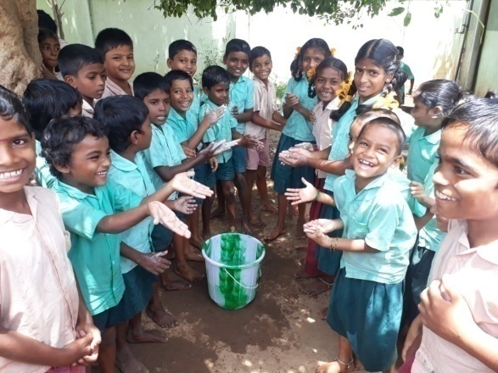
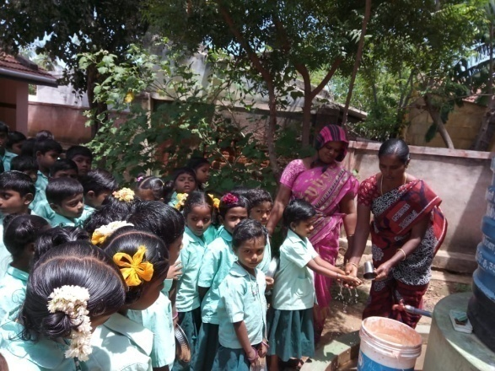
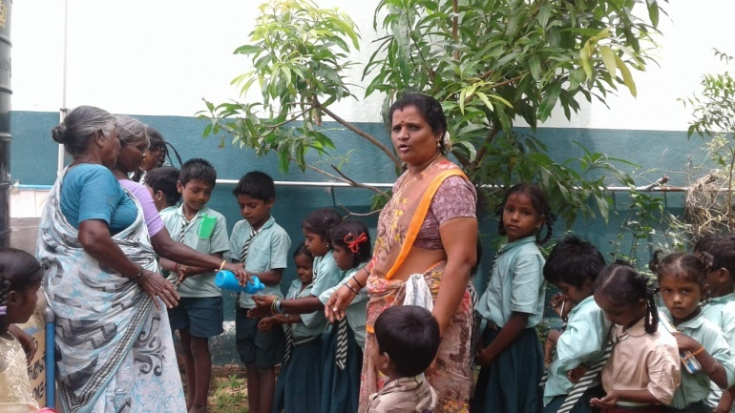
Teachers / Noon Meal Employees assisting children in encouraging hand wash using soap

Slide 14
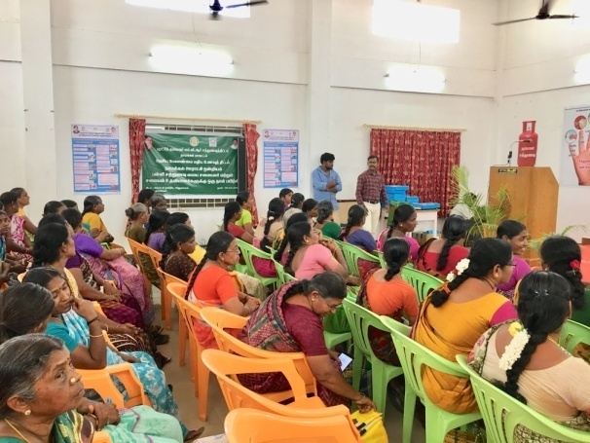
Training to Noon Meal Employees
Training programmes are organized at regular intervals to orient the employees on nutrition, health, personal hygiene like regular cutting of nails, washing their hands, cleaning of cooking and serving utensils, disposal of wastage, safety usage of LPG etc.,
Block level training on cluster basis.

Slide 15
Rashtriya Bal Swasthya Karyakram (RBSK)
School children in the age group of 6 to 18 years would be screened by mobile health teams.
73.4 lakhs children are covered under school health programme twice a year where de-worming tablets have been issued to the 71.7 lakhs children. 49.6 lakhs have been distributed with spectacles.
Notes:
r

Slide 16
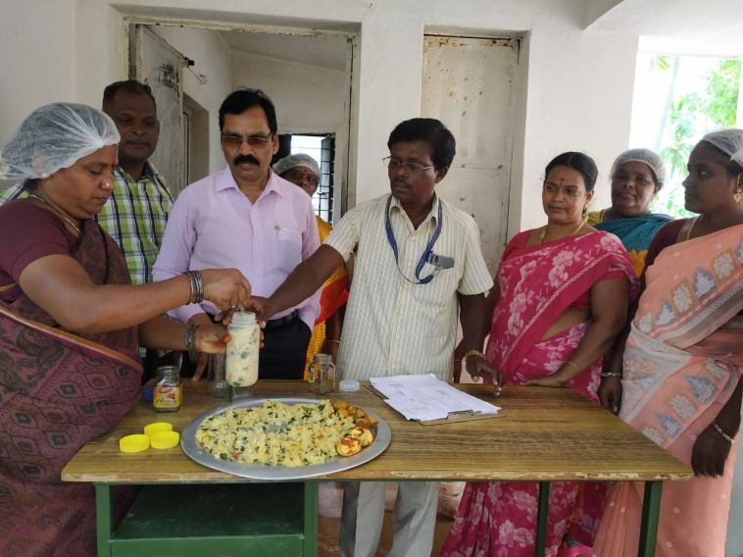
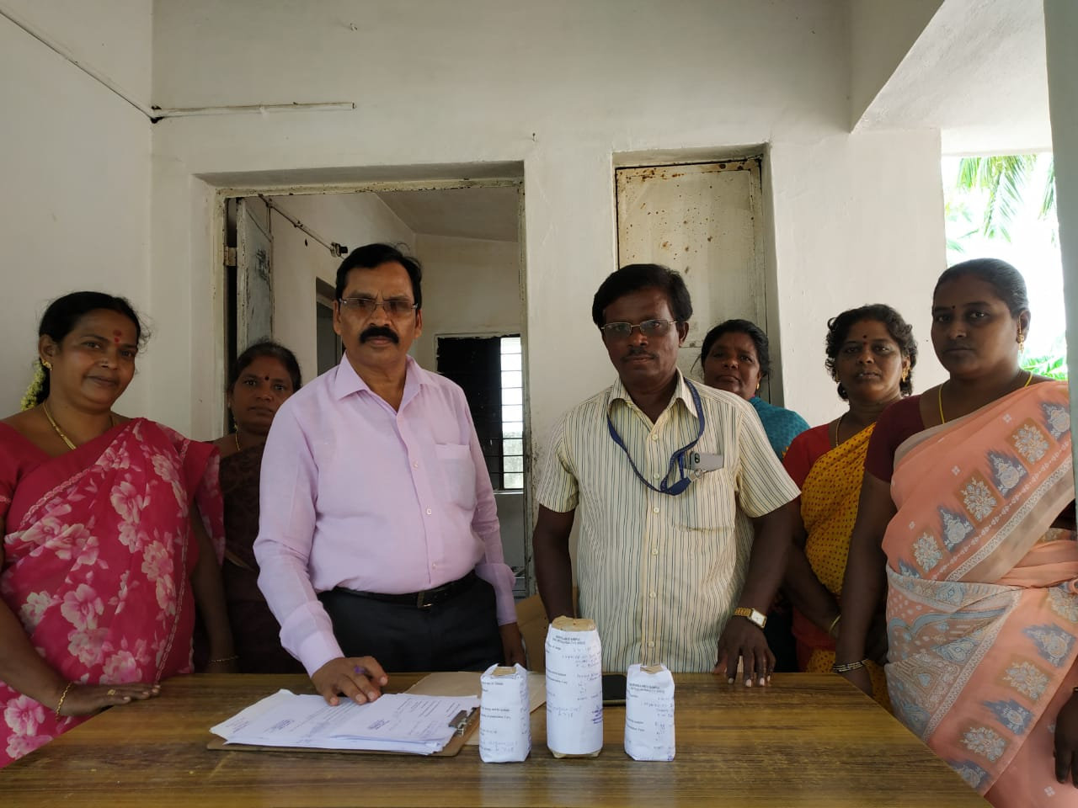
Registration of NMCs and Testing of Food Samples
All Noon Meal Centres have been registered under FSSAI.
Food samples are randomly collected and sent to the food testing
laboratory and the reports are received.

Slide 17
Automated Monitoring System
This system is being implemented from September 2017.
On an average 68% of HMs are sending the SMS on a regular basis.
The School Education Department have been addressed to instruct all the HMs to send the SMS regularly.
The best performing districts Tiruvannamalai, Dindigul, Kanniyakumari, Salem, Ariyalur and Theni have been appreciated and the District Collectors were given appreciation letter.

Slide 18
Expenditure upto March 2019
Rs in crore
S. No | Components | Fund released by GOI including OB | Expenditure | %
1. | Cost of Food grains | 35.97 | 23.55 | 65%
2. | Cooking Cost | 312.68 | 305.64 | 98%
3. | Honorarium to cook-cum-helper | 76.88 | 76.88 | 100%
4. | Transport Assistance | 8.99 | 4.71 | 52%
5. | MME | 7.82 | 7.82 | 100%
 | Total | 442.33 | 418.60 | 95%

Slide 19
Noon Meal Centres
Proposal for 2019-2020
Stage | 2018-2019 | 2019-2020 | Diff., | Remarks
Primary | 26801 | 26810 | +9 | During the academic year 2018-19, 85 schools were upgraded as Upper Primary.
Upper Primary | 16134 | 16210 | +76
NCLP | 270 | 263 | -7 | In Coimbatore (1), Karur (5) & Krishnagiri (1) districts NCLP centres closed.
Total | 43205 | 43283

Slide 20
Meal Cost fixed by GOI for per beneficiary / per day (excluding labour and administrative charges)
In Rs.
Class | MDM Norms (60:40) | Centre 60% | State 40% | Additional State contribution | Total
Primary (1 - 5 Std) | 4.35 | 2.61 | 1.74 | 2.51 | 6.86
Upper Primary (6 - 8 Std) | 6.51 | 3.91 | 2.60 | 0.45 | 6.96
9th & 10th | - | - | 100% contribution by State Government |  | 8.53
For 9 & 10th Std the entire expenditure is met out of State funds only.

Slide 21
Proposed Budget for the year 2019-2020
Rs. In crore
S. No | Components | Ratio | Amount proposed for 2019-20 in the ratio 60:40
 |  |  | Centre | State
1. | Cost of Food grains | 100% GOI | 34.49 | 0
2. | Cooking Cost | 60:40 | 299.83 | 199.61
3. | Honorarium to cook-cum-helper | 60:40 | 76.88 | 51.25
4. | Transport Assistance | 100% GOI (Rs.1500/- per MT) | 17.24 | 0
5. | MME | 2.7% of the central share | 11.57 | 0
 | Total |  | 440.01 | 250.86

Slide 22
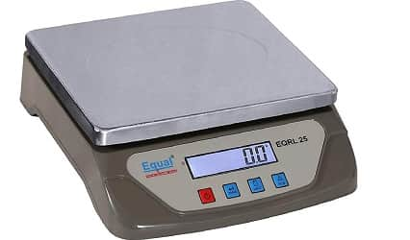
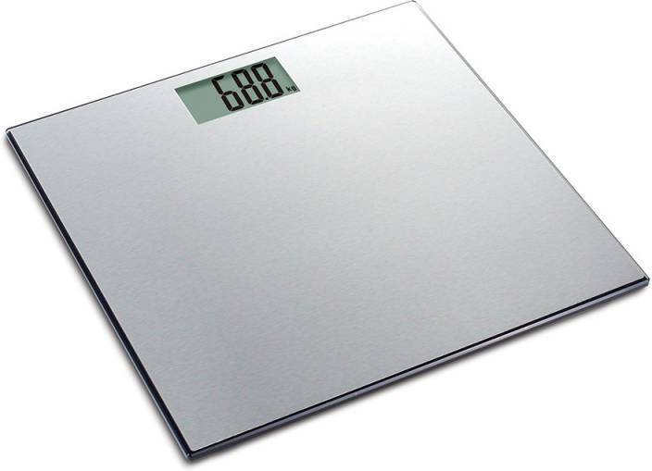
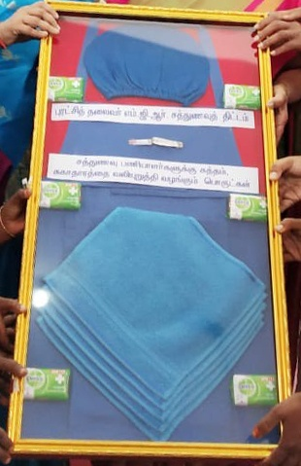
SPECIAL INITIATIVES
WEIGHING SCALE (To weigh the food commodities) Digital weighing scales weighing 1 gm to 10 kg at a cost of Rs. 185.76 lakhs provided to all Noon Meal Centres through Tamil Nadu Medical Services Corporation. WEIGHING SCALE (to monitor the weight of children) : To monitor the weight of the children 268 weighing scale @ cost of Rs. 45.75 lakhs is provided to 4 districts.
HYGIENE KIT To follow the hygiene practices before cooking the meals all the noon meal cook / cook assistants have been provided with 2 aprons, 1 head cap, 1 nail cutter, 5 hand towels, 6 antiseptic soaps at a cost of Rs. 500/- each.

Slide 23
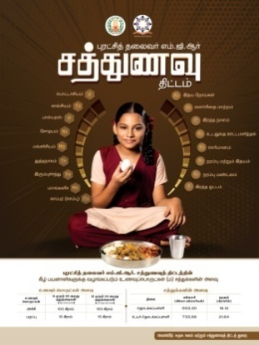
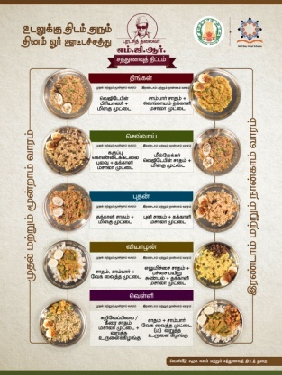
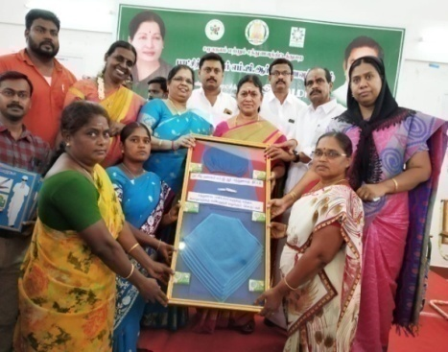
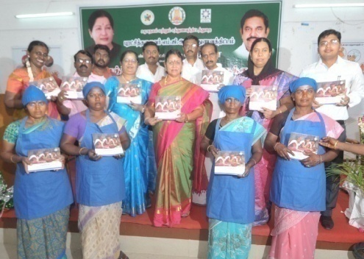
SPECIAL INITIATIVES
IEC Activities Posters: 3 posters on different theme of Noon Meal and hand manuals at a cost of Rs. 64.81 lakhs were distributed to all districts
Short film : A short film (with English Subtitle) to create awareness has been produced at a cost of Rs. 3.17 lakhs.

Slide 24
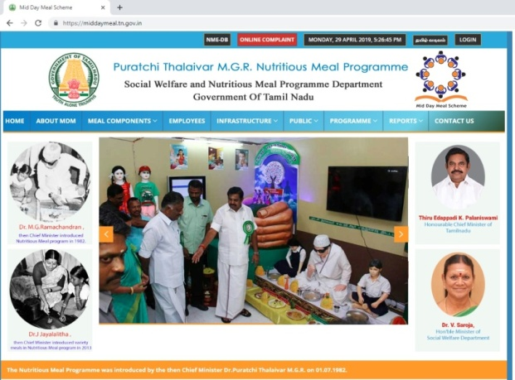
SPECIAL INITIATIVES
Website Exclusive website for Mid Day Meal
 | Digitalization Data of the Noon Meal Employees is digitalized.

Slide 25
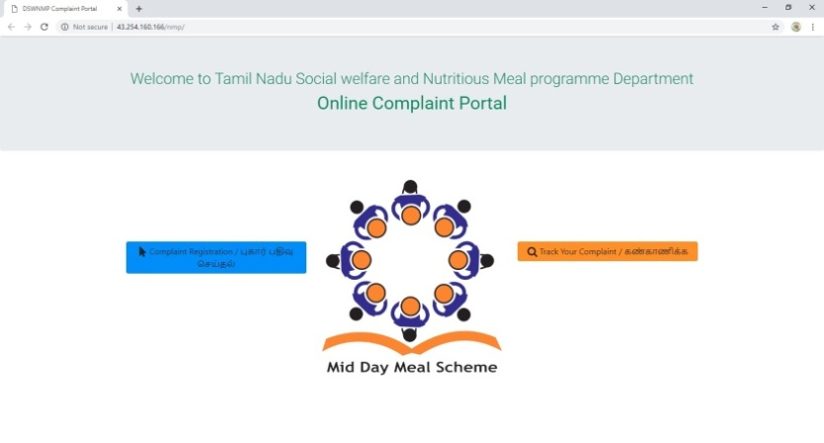
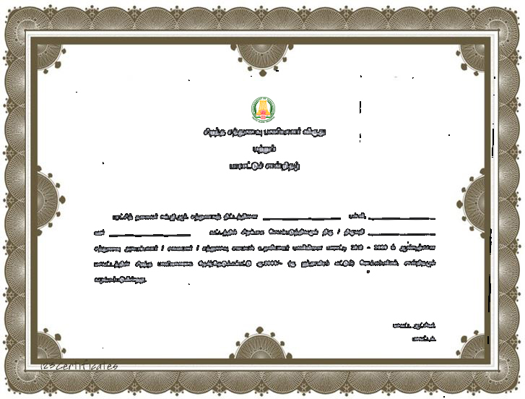
SPECIAL INITIATIVES
Online grievance : Software was created at a cost of Rs. 5.00 lakhs to register complaints if any.
 | Awards It has been decided to provide cash award of Rs.5000/- along with a Certificate to the Noon Meal Employees in each district based on their performance,

Slide 26
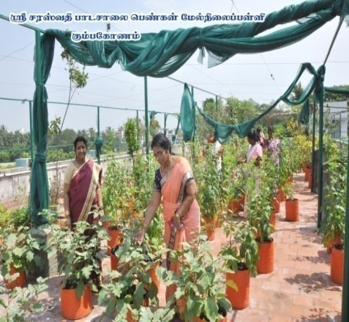
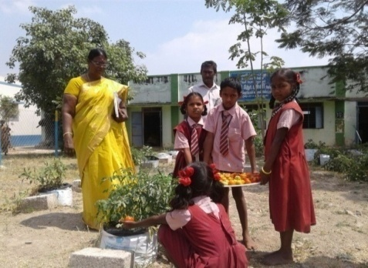
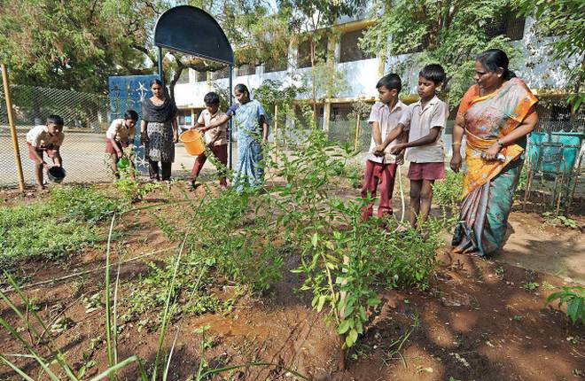
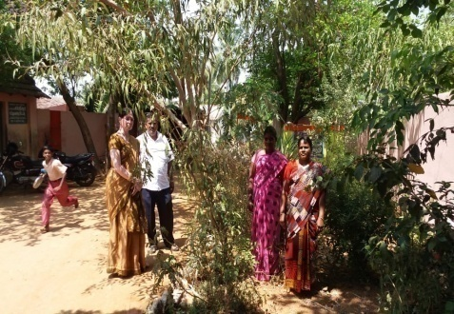
SPECIAL INITIATIVES
Training to Noon Meal Employees Training has been imparted to all the Noon Meal Organizers / Cook and cook assistants.
 | Kitchen garden Kitchen garden has been setup in all the Noon Meal Centres in co-ordination with the Horticulture Department.

Slide 27
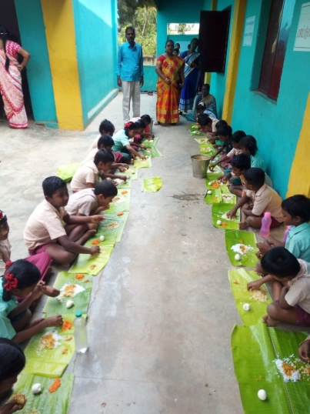
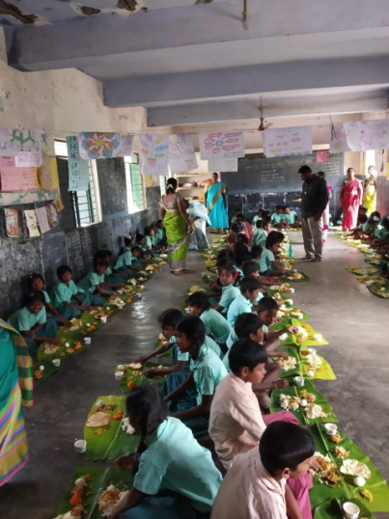
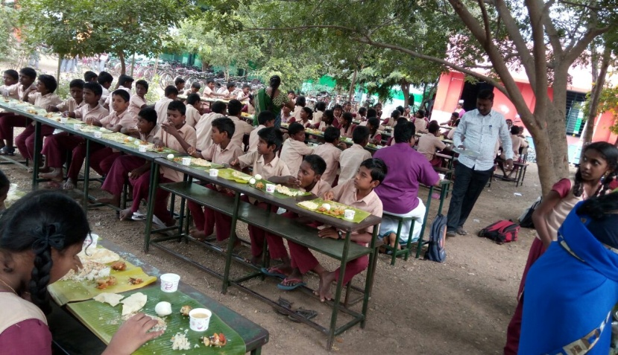
SPECIAL INITIATIVES
TITHI BHOJAN On the occasion of the 150th Birthday of Mahatma Gandhi on 2.10.2018 Tithi Bhojan [நல்விருந்து - Nalvirunthu] was planned and executed.

Slide 28
SPECIAL INITIATIVES
Fortification of Rice Government of Tamil Nadu under the Innovative Initiative is piloting rice fortified with 9 micro nutrients as per FSSAI guidelines, in 5 districts under MDM / ICDS at a cost of Rs. 529.25 lakhs from this academic year. The blending machine will be installed in TNCSC godowns . The tender has been finalized as FRK – Rs. 107.09 per kg Blending machine – Rs.46.93 lakhs/- Baseline study has been conducted in the 5 districts.

Slide 29
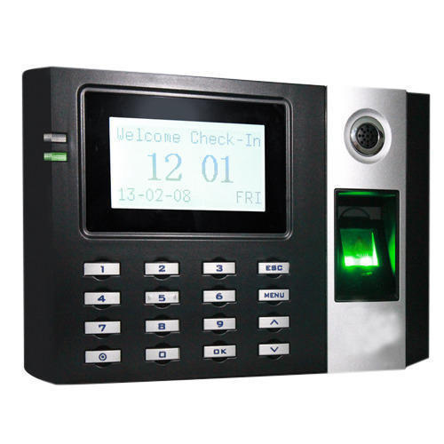
UPCOMING INITIATIVES
ISO Certification of NMC Government have ordered to certify 100 Noon Meal Centre under ISO 9001:2015 at the cost of Rs. 20 lakhs which will ensure the quality of service, Infrastructure & which will give a facelift to the scheme.
 | BIOMETRIC ATTENDANCE Government has ordered to pilot biometric attendance in 10 schools in Greater Chennai Corporation at the cost of Rs. 4 lakhs.

Slide 30
T
H
A
N
K
You

